Slide 1


Now What?: Putting Drought Risk Management Practices Into Action
Mark Svoboda, PhD
Director and Professor
University of Nebraska-Lincoln
Armenia Visegard Project on Droughts Stakeholder Workshop
Armenia/Virtual
October 11, 2023

Slide 2
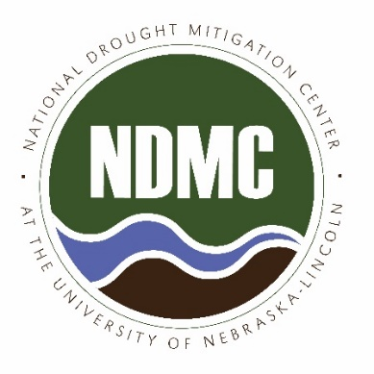

National Drought Mitigation Center (NDMC)
Educators and Students
Media
Monitoring + Early Warning
Policy + Decision Makers
Policy + Planning
General Public
Vulnerability and Risk Assessment
Other Scientists
Services, Education, Outreach, & Engagement
Drought Science (27 Staff: 50-50 mix)
Usable, Actionable, & Policy Informing Information
Notes:
Bridge organization
Translate science that we, and others, produce

Slide 3
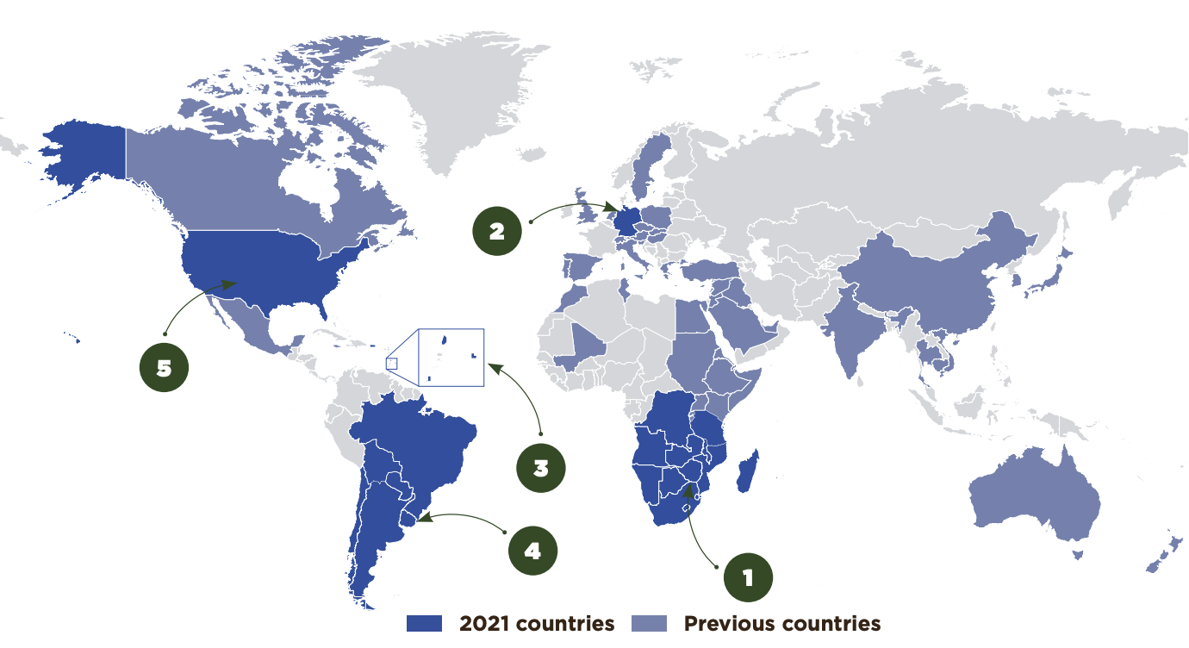
Where We Work
NOAA/NIDIS, USDA, NASA
UN organizations: FAO, ISDR, UNDP,
UNDRR and UNCCD
World Meteorological Organization
USAID
World Bank
WMO/Global Water Partnership:
Integrated Drought Management
Program (IDMP)
Various regional and national climate
centers
Numerous government agencies and
universities in different countries

Slide 4
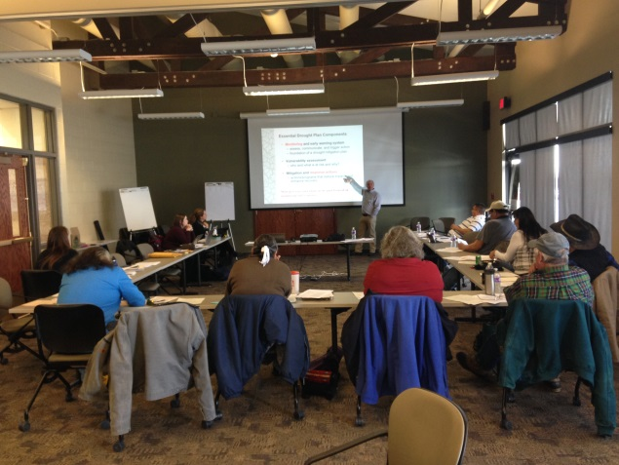
Drought Planning Context
Planning is undertaken within a range of contexts
  Legislation or agency mandate
  Stakeholder-driven (grassroots)
  Substantial or limited funding
  Covering a few or broad range of sectors
  (e.g., ag, water, fire, energy, health, etc.)
  Short time-frame or multi-year effort
  Stand-alone or part of another plan
  No one size fits all or prescribed approach!
Need to determine the planning process that will work for you

Slide 5
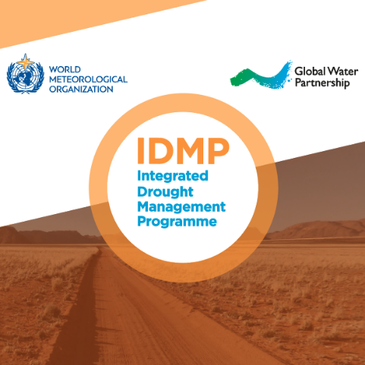
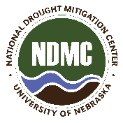
Essential Drought Plan Components
Drought early warning system
  monitor, communicate, and trigger actions
Risk assessment
  who and what is at risk from drought and why?
Mitigation and/or response actions
  actions/programs that reduce impacts and enhance recovery
Early Warning
Risk Assessment
Mitigation & Response
Three pillars of drought risk management

Slide 6
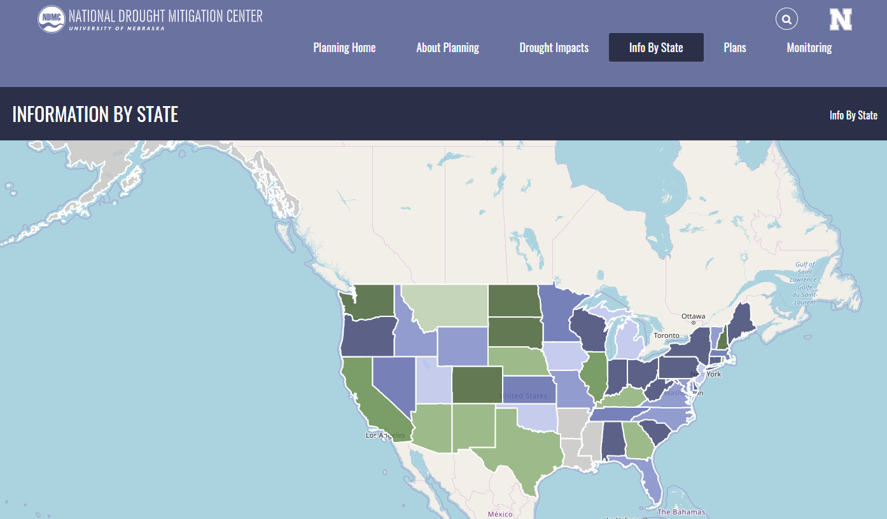
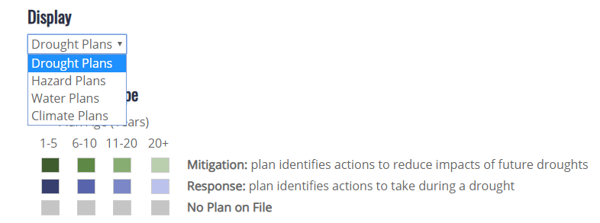
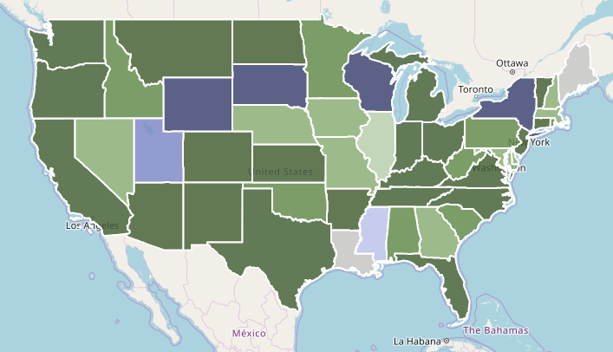
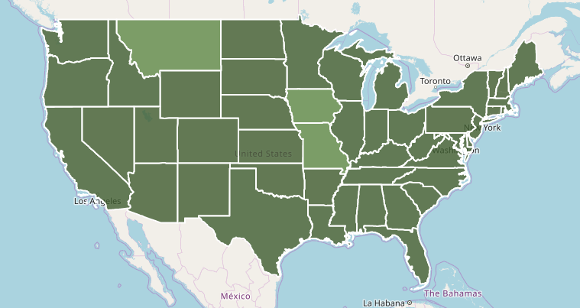
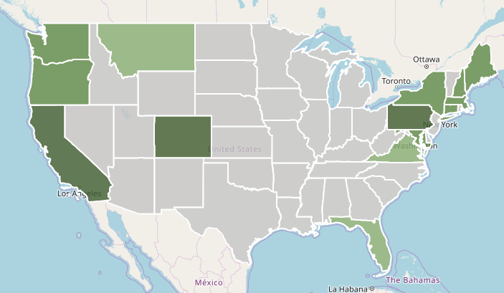
Developing a range of plans that could include drought
State Drought Plans
Water
Hazard
https://drought.unl.edu/droughtplanning/InfobyState.aspx
Climate

Slide 7
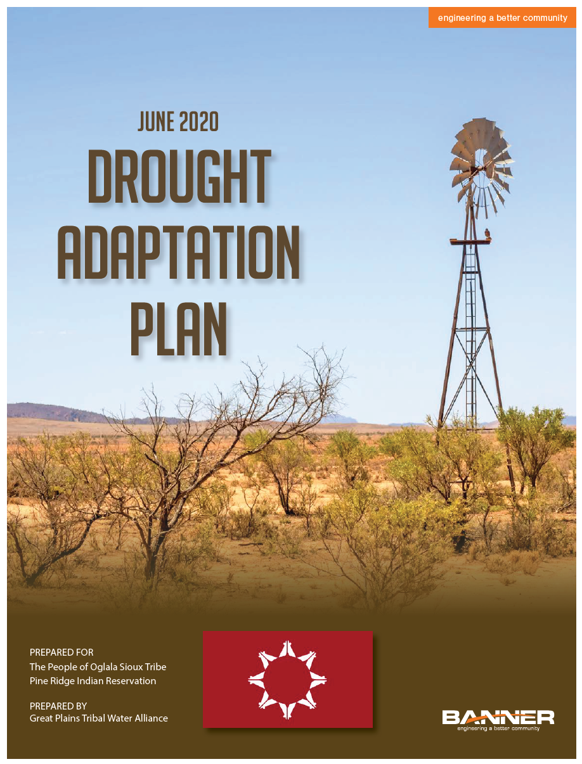
Engagement with Tribal Nations
NDMC has worked with Tribal Nations for more than 20 years on drought planning
  outreach, technical assistance and advisory services
EX: NDMC, HPRCC, NIDIS and consultants partnered on BIA-supported drought vulnerability assessments and drought adaptation plans with the:
  Flandreau Santee Sioux Nation
  Oglala Sioux Nation
  Rosebud Sioux Nation
  Standing Rock Sioux Nation
There are more:
  nations developing drought and climate change plans, funding for planning and mitigation measures, and tribal partnerships with federal and other agencies
Could use more:
  tribal-specific information, resources, and program coordination
Notes:
In regard to the last bullets, more tribal nations are developing drought and climate change plans because there is money to do so being provided primarily by BIA, or as part of muliti-hazard planning by FEMA. Additional agencies such as BOR, NIDIS, and others are also now beginning to provide additional funds for drought mitigation and response projects, which is helpful. However, many tribes still lack tribal-specific monitoring and impact information and the technical capacity to develop plans. In addition, most agencies now how tribal liaisons or fund tribal staff (i.e., NIDIS, USDA NRCS, EPA, USGS CASCS, USDA Climate Hubs, so more coordination of activities would be helpful – along with programs/projects that focus on providing technical training to many tribes at once vs. on a tribe by tribe basis.

Slide 8
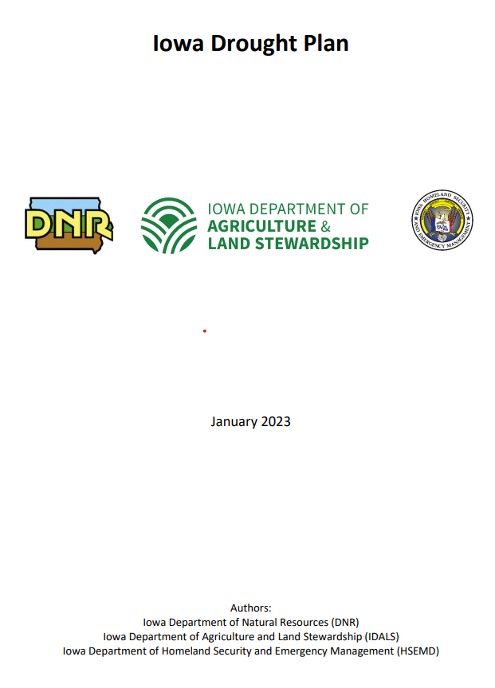
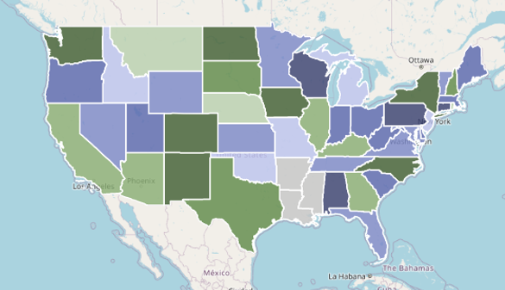
Iowa Drought Planning
State of Iowa, NDMC, and USDA Midwest Climate Hub project to develop the Iowa Drought Plan
NDMC support sponsored by the USDA-OCE
Planning team activities in 2021-2023 included:
  NDMC provision of training and plan examples
  Bi-weekly team meetings to develop plan content
  Stakeholder meetings during the summer of 2022
  Finalization of the plan in January 2023
  Iowa Drought Planning Tabletop Exercise in February to test the plan
  NIDIS-sponsored Midwest DEWS regional webinar in March to advertise the effort
  Drought planning case study in development
Available on NDMC State Drought Plan Database
drought.unl.edu/Planning/DroughtPlans
Notes:
During this project, the NDMC worked with the Iowa Drought Planning Team (DPT) to finalize, test, and publicize their state drought plan. The Iowa DPT primarily includes representatives from the Iowa Department of Agriculture and Land Stewardship, Iowa Homeland Security and Emergency Management Department and Iowa Department of Natural Resources, along with Dennis Todey, Director of the USDA Midwest Climate Hub.
Knutson and Smith met with members of the Iowa Drought Planning Team (DPT) every two weeks since the spring of 2022 to discuss their planning process, provide input, and review drafts of the plan. Specifically, the NDMC provided drought planning guidance materials and example drought plans; expert opinion on the development of each component of the drought plan (i.e., leadership structure, drought monitoring, risk assessment and management options); advice on seeking stakeholder engagement and the facilitation of a series of stakeholder input sessions across Iowa in July; and a list of potential mitigation actions for the state to consider for adoption.
Knutson and Smith met with the DPT on 10/19/22 and 12/14/22 to review final iterations of the Iowa State Drought plan, which was approved and placed on the Iowa Department of Natural Resources website in January, 2023.
Knutson and Bathke participated virtually in the Iowa Drought Planning Tabletop Exercise on 2/15/23 with relevant Iowa agencies to review the drought plan and agency roles and recommend changes to be considered in the next update of the plan expected to be in early 2024.
Knutson met with Tim Hall from the Iowa Department of Natural Resources on 2/21/23 to discuss the benefit of NDMC drought planning information and expertise provided to the DPT. Generally, Hall felt that the information and expertise was especially valuable in deciding how to begin the planning process, learning about the primary steps involved in the process, issues that were raised by the NDMC to consider throughout the planning process, and drought plan components from other states that were highlighted from which Iowa could draw upon (rather than starting from scratch). Hall will provide a more thorough assessment of materials provided by the NDMC within the near future.
Knutson participated in the Midwest DEWS Webinar: The Iowa Drought Plan on 3/14/23 along with Iowa DPT members. The members described the drought planning process and resulting plan, and Knutson provided reflections on lessons learned during the Iowa drought planning process. The Iowa DPT, NDMC, USDA Midwest Climate Hub and NOAA NIDIS are now planning to develop a case study of the drought planning process for publication.

Slide 9
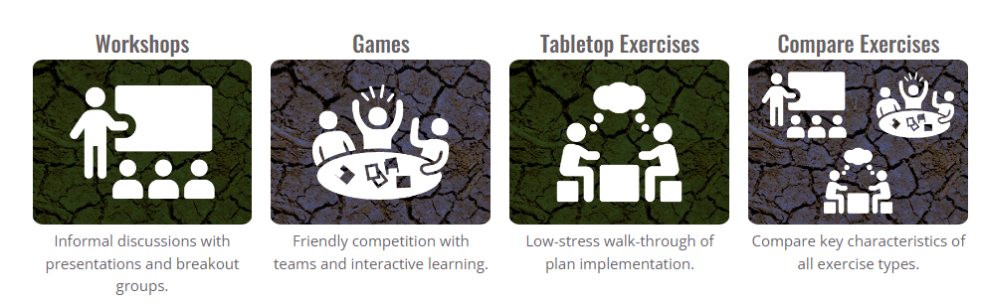
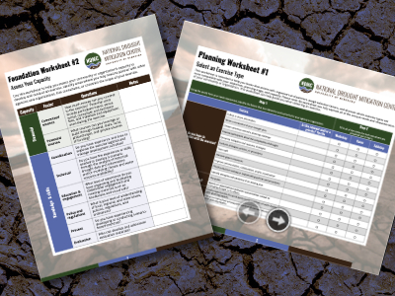
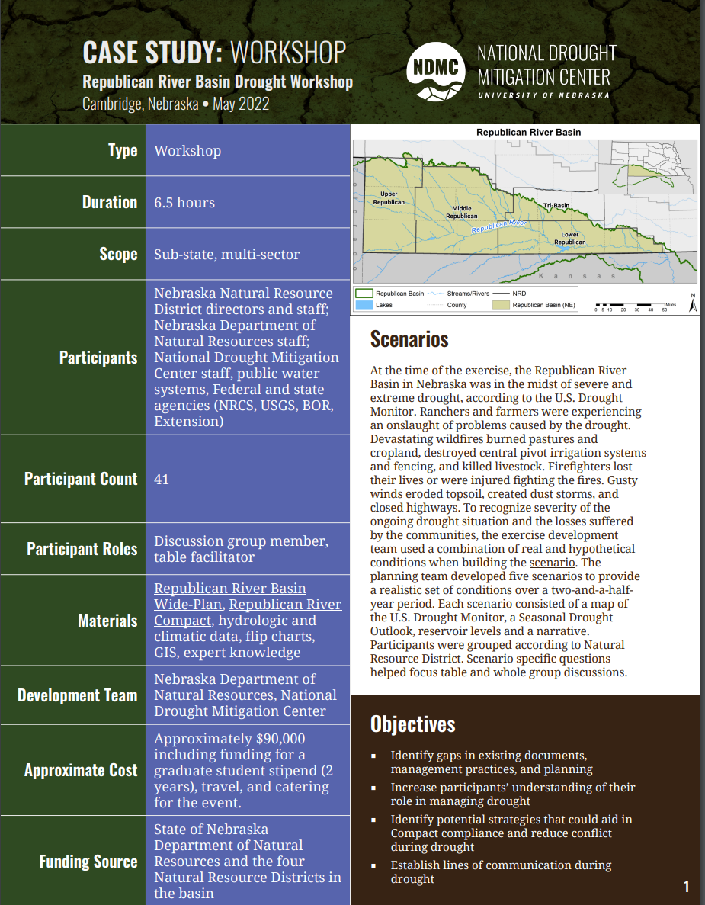
Collaborative Drought Planning Using Scenario Exercises https://drought.unl.edu/scenarioguide/
https://drought.unl.edu/scenarioguide/
Website is built upon:
28 years drought planning expertise
26 exercises over 13 years in 10 states and 5 countries with more planned
5 publications
Includes:
18 worksheets to help plan, design, facilitate, & evaluate exercises.
10 case studies with scenario information, goals, outcomes, agendas & more.
2022 stats: 1366 unique users; 1556 sessions; 2754 page views
Funding provided by USDA through the North Central Climate Collaborative and the North Central Regional Center for Rural Development
Notes:
Collaborative Drought Planning Using Scenario Exercises is an interactive website that provides information and tools to help plan drought scenario-based exercises — structured, interactive activities designed for engaging decision-makers, stakeholders, planners, emergency managers, and others in the process of planning and managing a hypothetical drought.
This website is based on the NDMC’s
28 years experience in drought planning
18 years experience in developing, convening, facilitating, and evaluating drought scenario exercises over ~13 years in 10 states and 5 countries
The guide has been broken down into four sections, each with background information, tips, examples, and tools to help you understand roles that scenario-based exercises can play in reducing drought risk and to select and begin planning an exercise for your community or organization. The website includes 18 worksheets, 10 case studies (with more on the way) with each containing
A scenario overview,
Exercise goals
Outcomes and evaluation information
Agendas and more.
The website is regularly updated to reflect our latest experiences.

Slide 10

Sample outcomes
Can help “guide” a planning process or “test” an existing plan
Design
North Platte NRD Drought Tournament (2016)
Informed the 2021 Nebraska state MHMP
Northwest Iowa Drought Preparation Workshop (2020)
Highlighted the need for and led to the development of the 2022 Iowa drought Plan
Led to the development of an online drought THIRA planning process for emergency managers
Led to the development of the 2017 North Platte NRD Community drought plan
Platte River Basin Drought THIRA (2017)
Caribbean Virtual Drought Exercise (2022)
1st time the 3 states were in the same room since the 2021 Supreme Court ruling.
Board voted to make this an annual event.
“WATER” you thinking about drought? (2022)
Exposed Alaska residents to drought monitoring and management
Informed the development of a protype Alaska CDI
ACF River Basin Drought Tabletop Exercise (2023)
Used NDMC research tying impacts to indicators to help establish response triggers in drought plans of individual nations
Notes:
When we work with communities to develop exercises, we use a process called backwards design where the exercise type, questions, and format are developed based on THEIR desired outcomes. This slide shows a few sample outcomes from recent exercises.

Slide 11
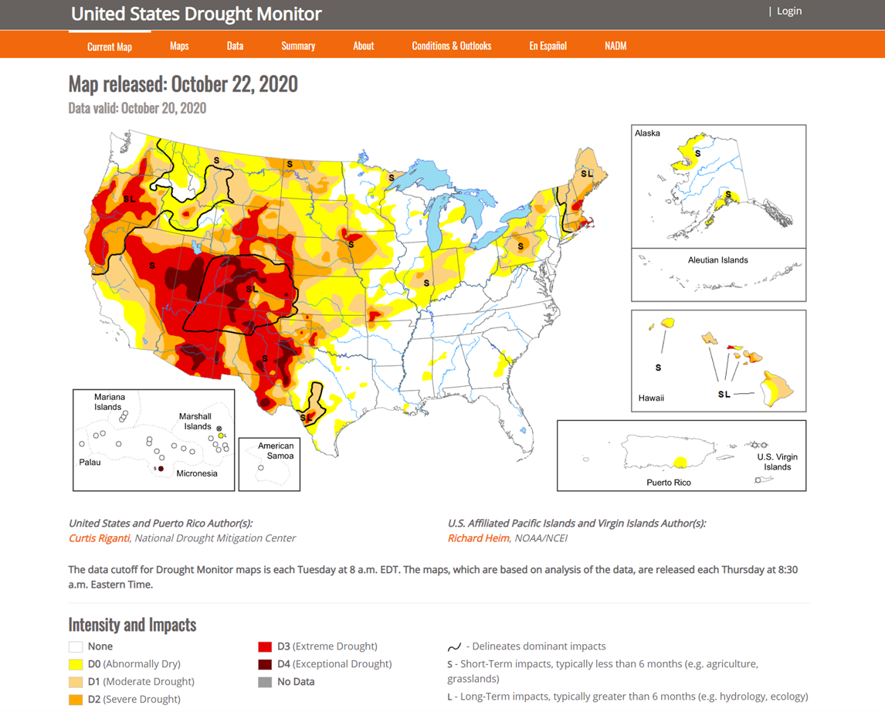

U.S. Drought Monitor (USDM):
(Science before Policy)
State-of-the-science drought assessment in the U.S. since 1999
  Collaborative effort between NOAA, USDA and NDMC
Composite indicator blends objective indicators and indices with field input from over ~450 experts
“Convergence of Evidence” approach
Policy implications in Farm Bill (USDA), IRS, Federal Reserve Board, CDC, FERC, NOAA-NWS and several state drought plans and task forces
“Go to source” for media and the public
  ~12+ million page views annually

Slide 12
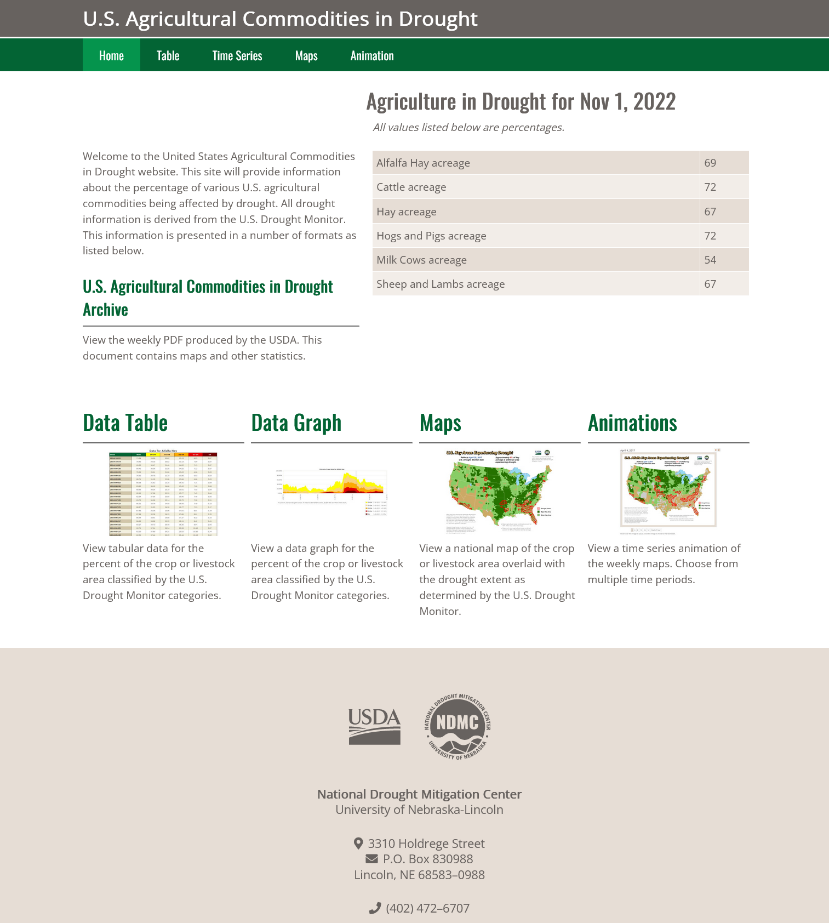
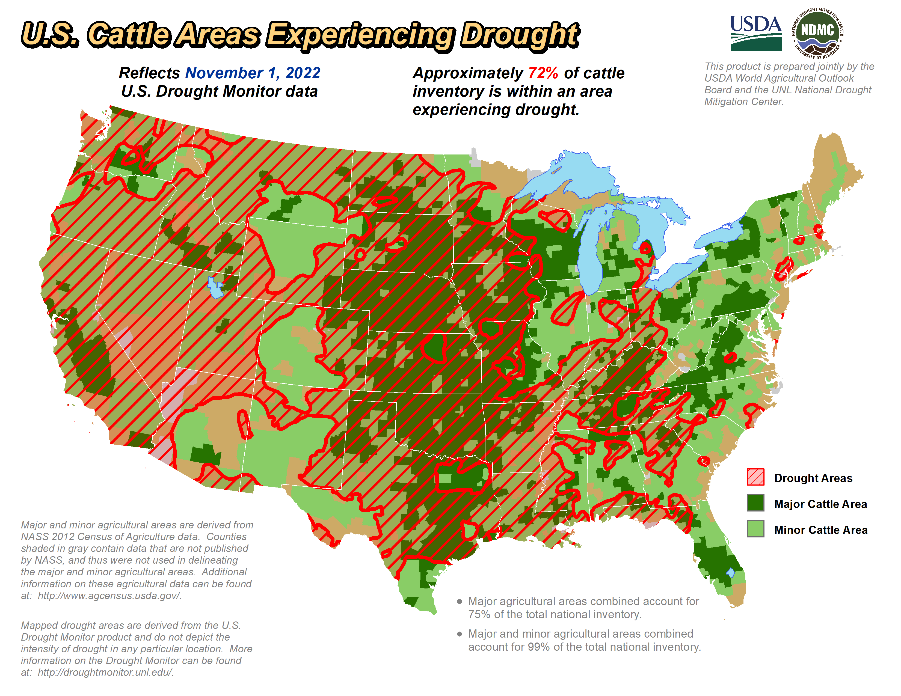
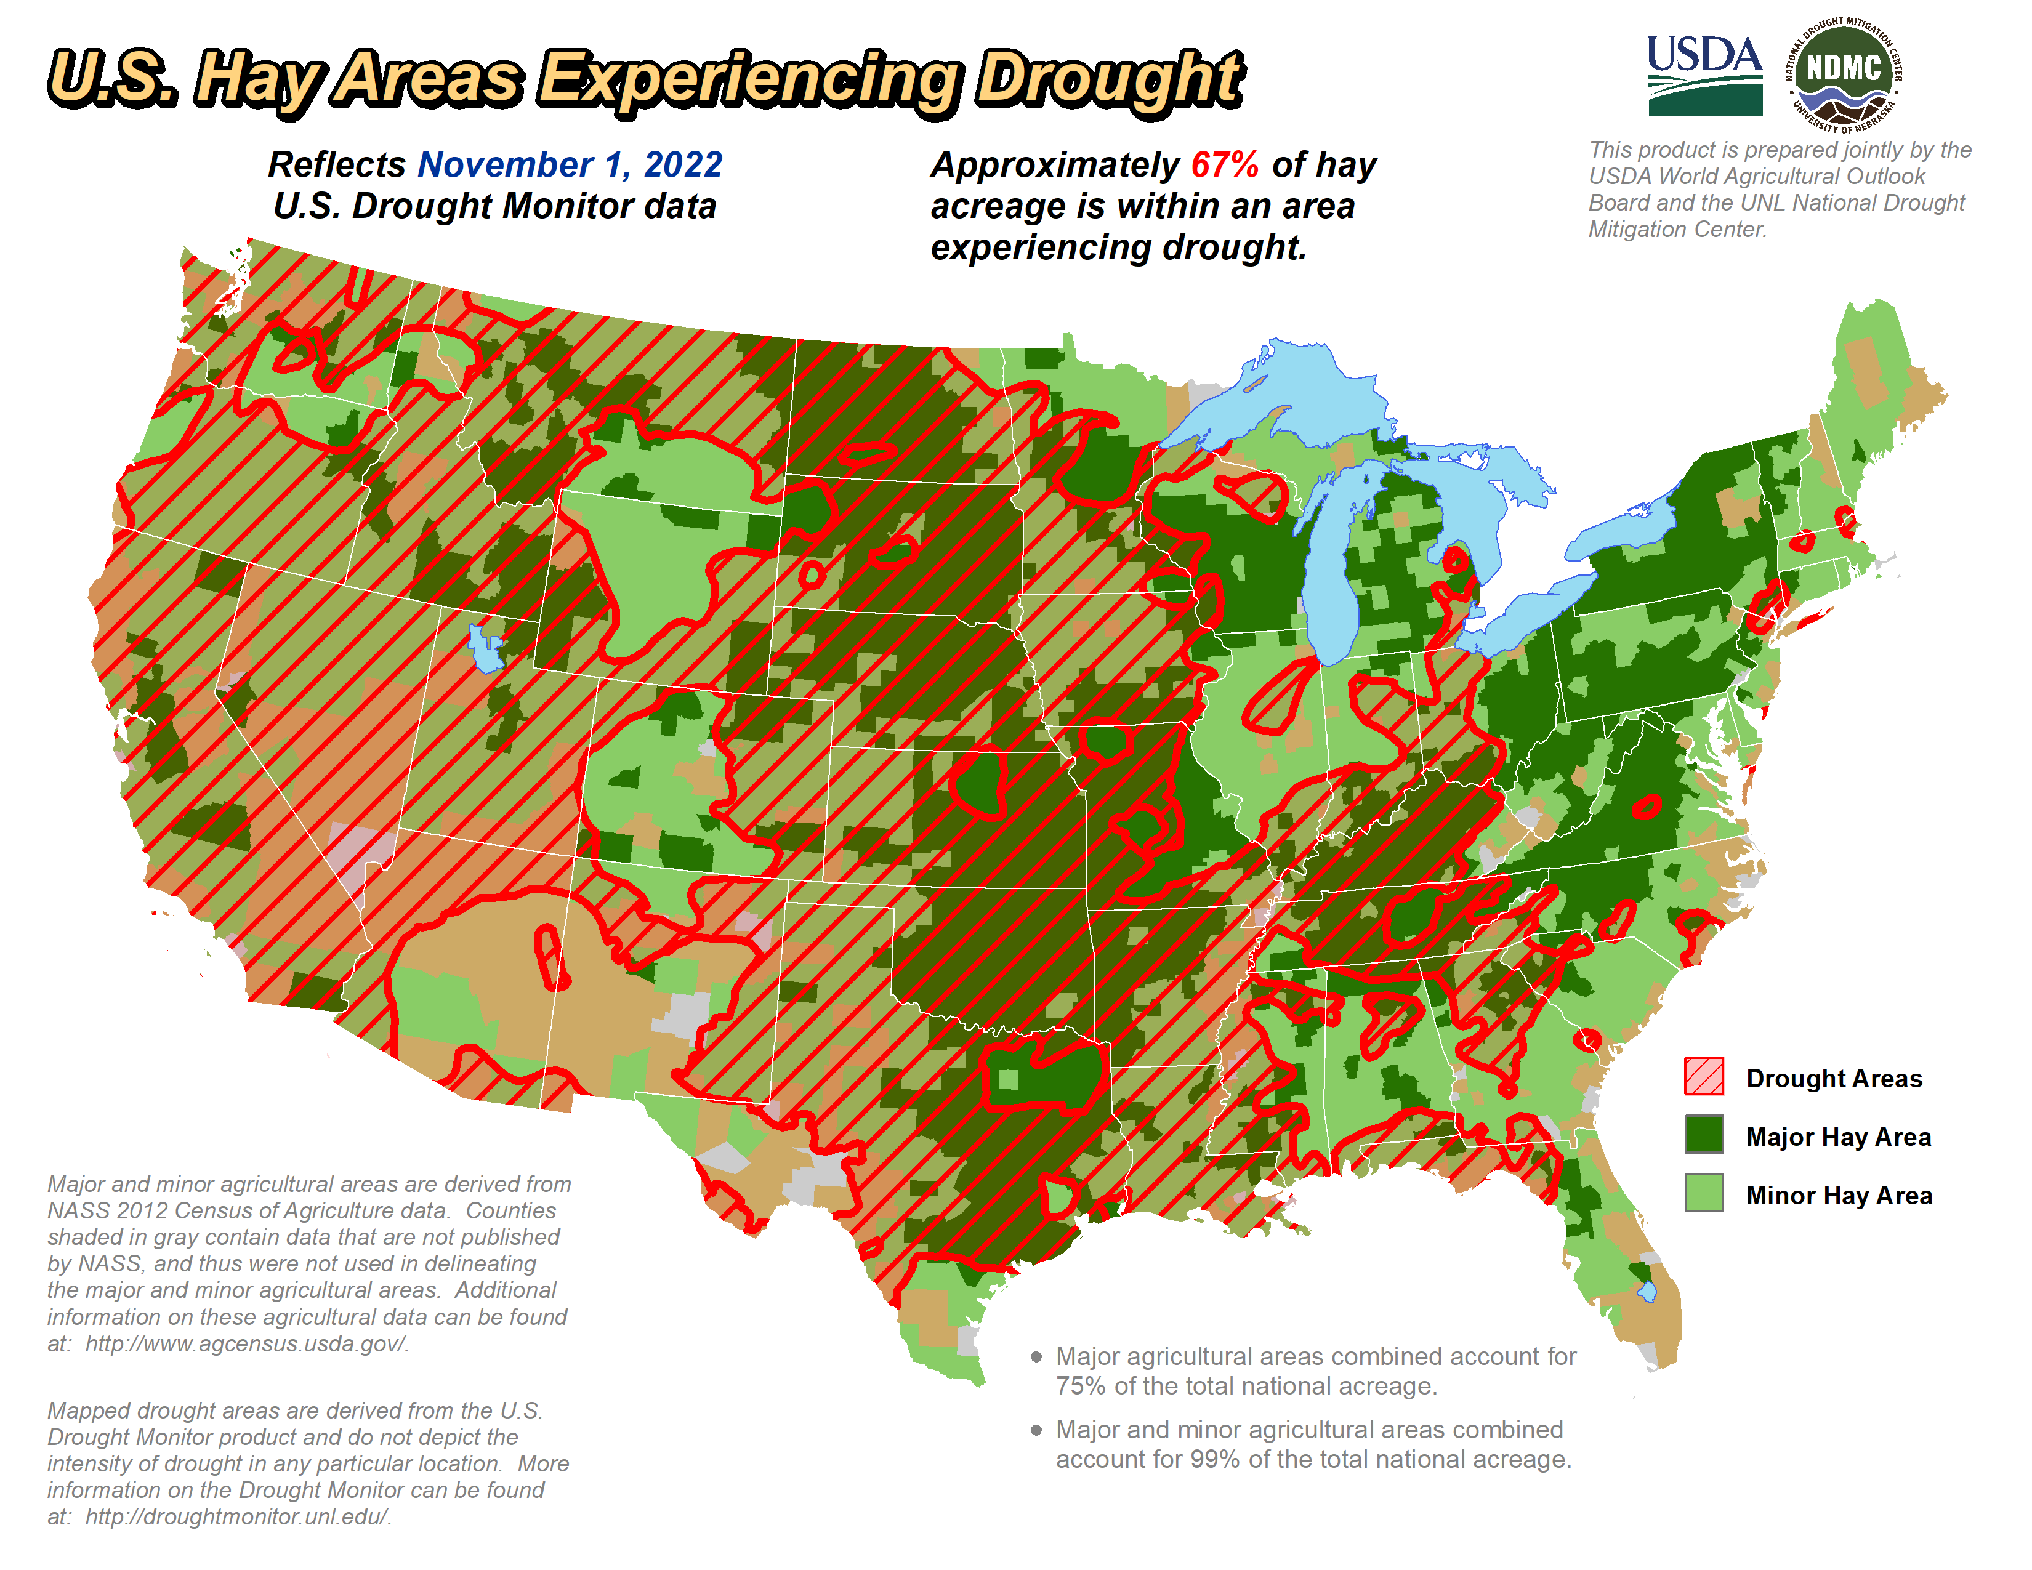
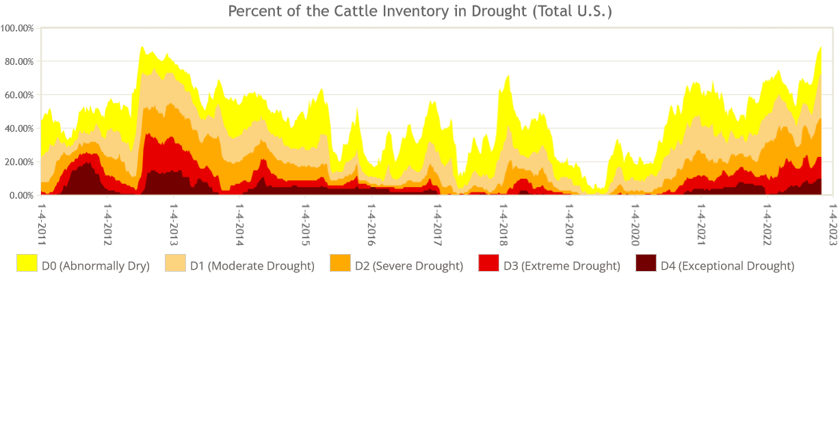
USDA-OCE and NDMC Services

Slide 13
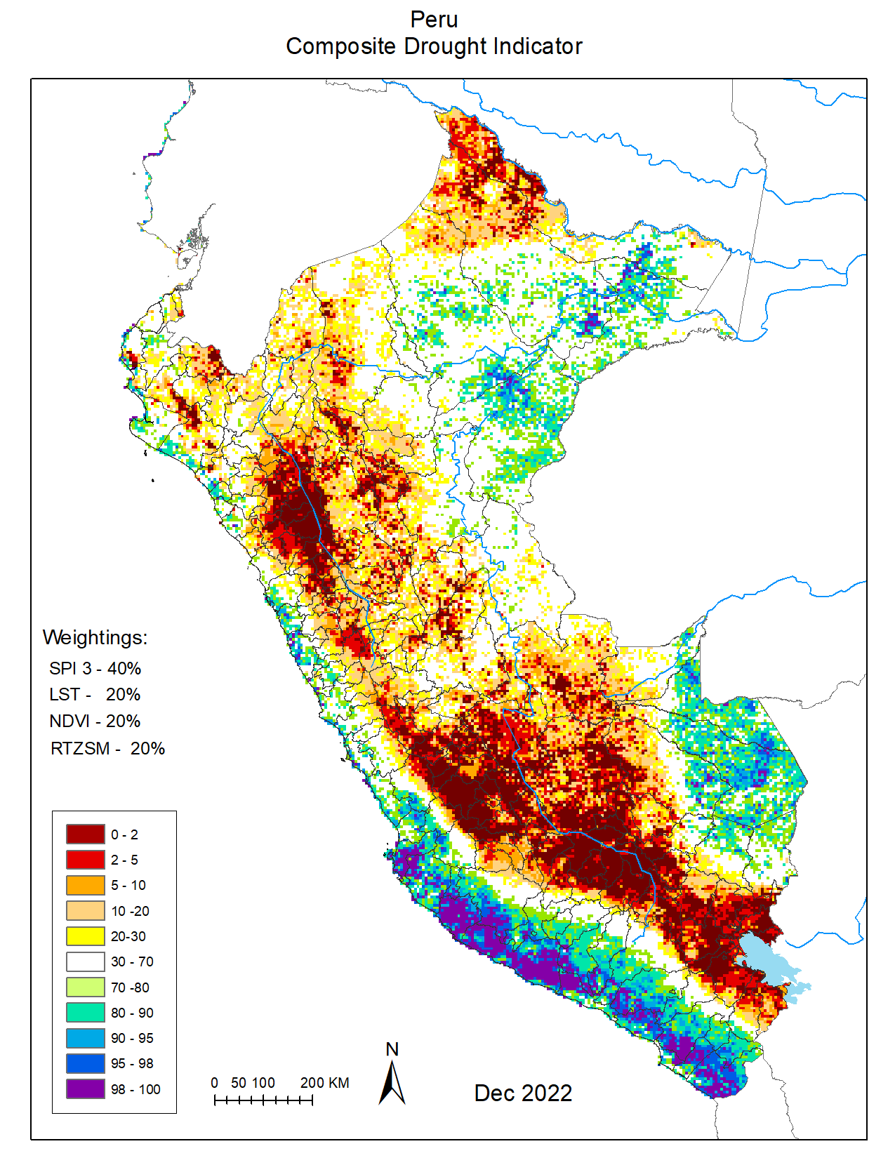

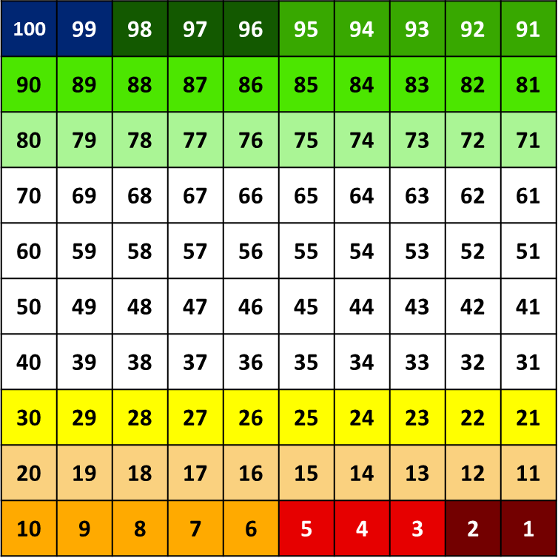
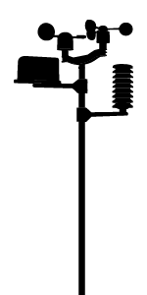
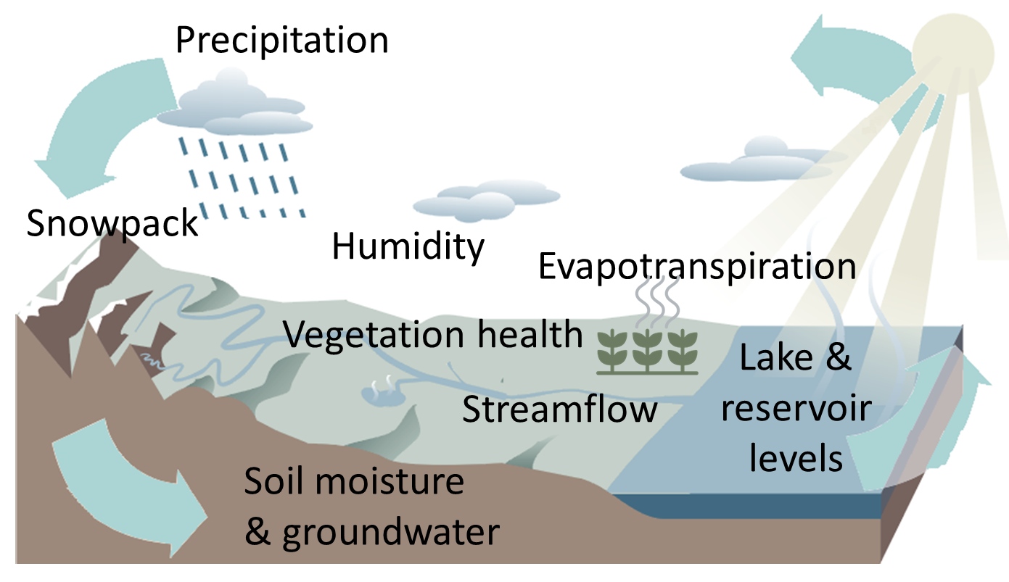

Developing a Composite Drought Indictor
1
3
4
5
2
Collect climate
data
from satellites, surface observations, or computer models
Select drought indicators
based on data availability, quality, and decision-making
needs
Put data in historical context
percentile method is used to rank data
and assign
severity
Assign relative
weights
by expert judgement or by machine learning
Blend data and
create map
into a single product with relevant information (“triggers”) distilled for drought management
NATIONAL DROUGHT MITIGATION CENTER
Notes:
This is an example of the CDI process we followed with our partners in Jordan. This same process is/was followed with our partners in many of the countries shown earlier on the global example CDI slide.
Collect climate data from satellites, surface observations, or computer models
Select drought indicators based on data availability, quality, and decision-making needs
Put the data into historical context, using a method such as percentile ranking, and assign drought severity levels.
Assign relative weights of the different drought indicators. This can be based upon by expert judgement of project scientists and in-country consultants or by machine learning.
Blend the data into a single product and create a map. The final map should be relevant and useful for drought management.

Slide 14
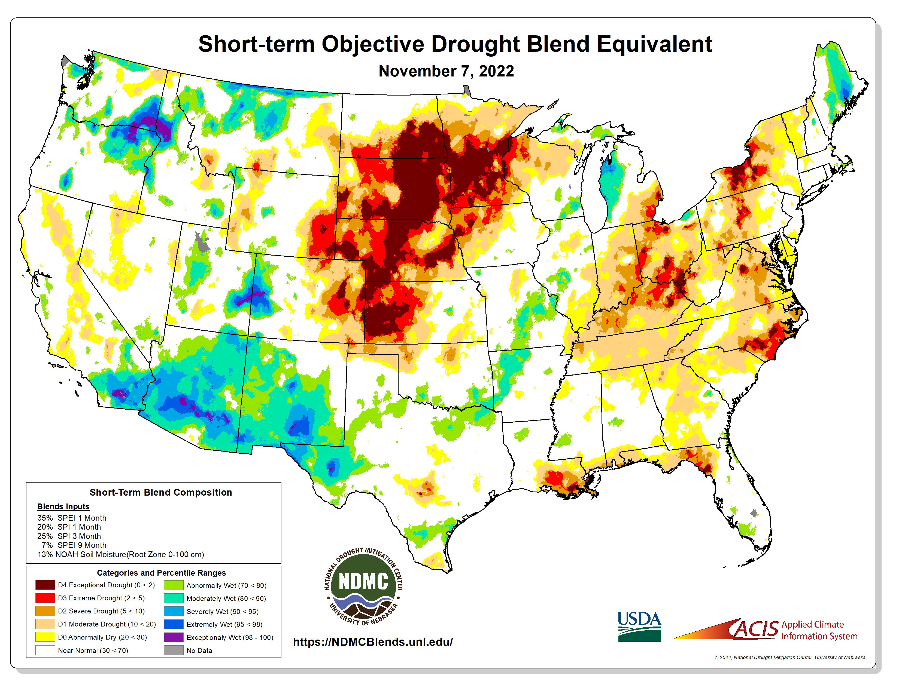
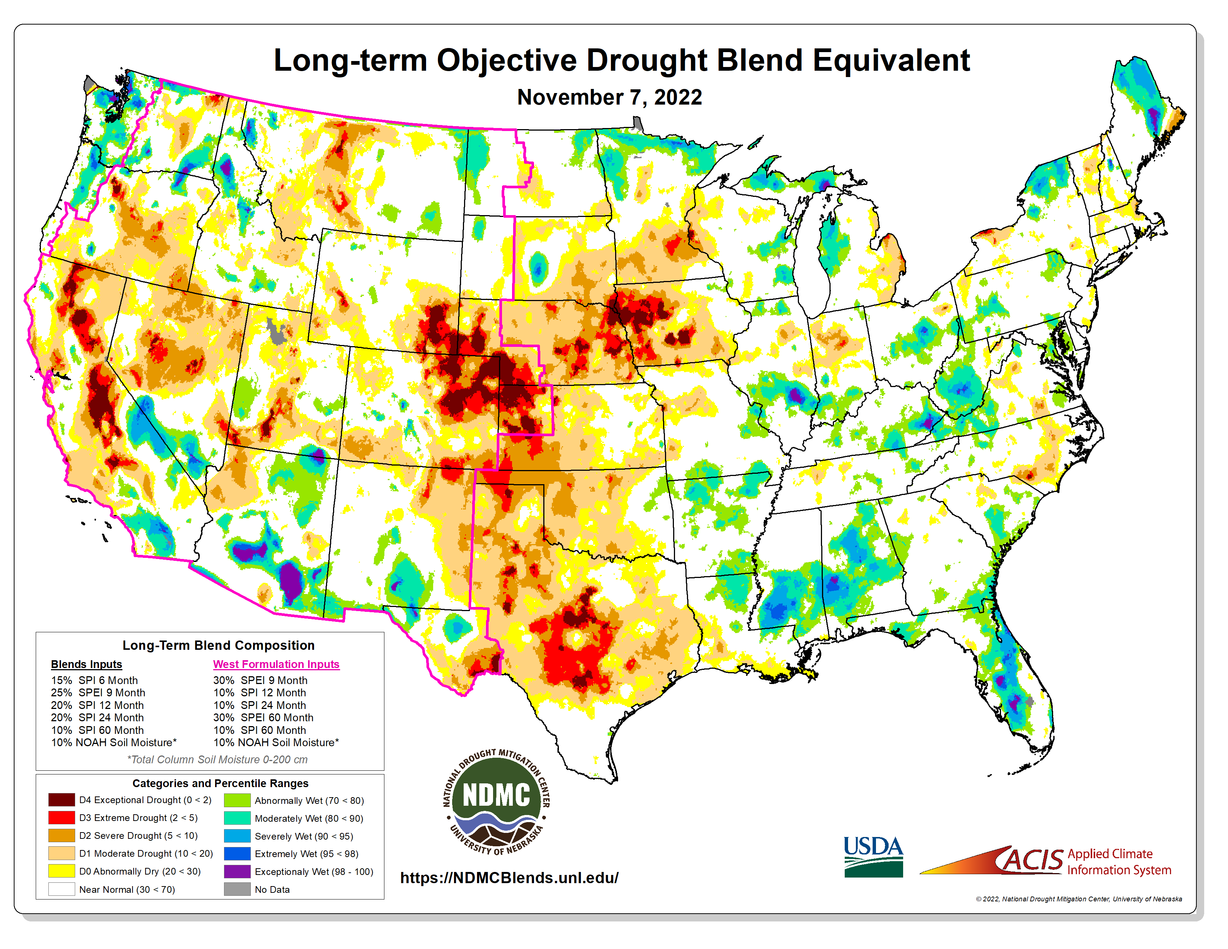
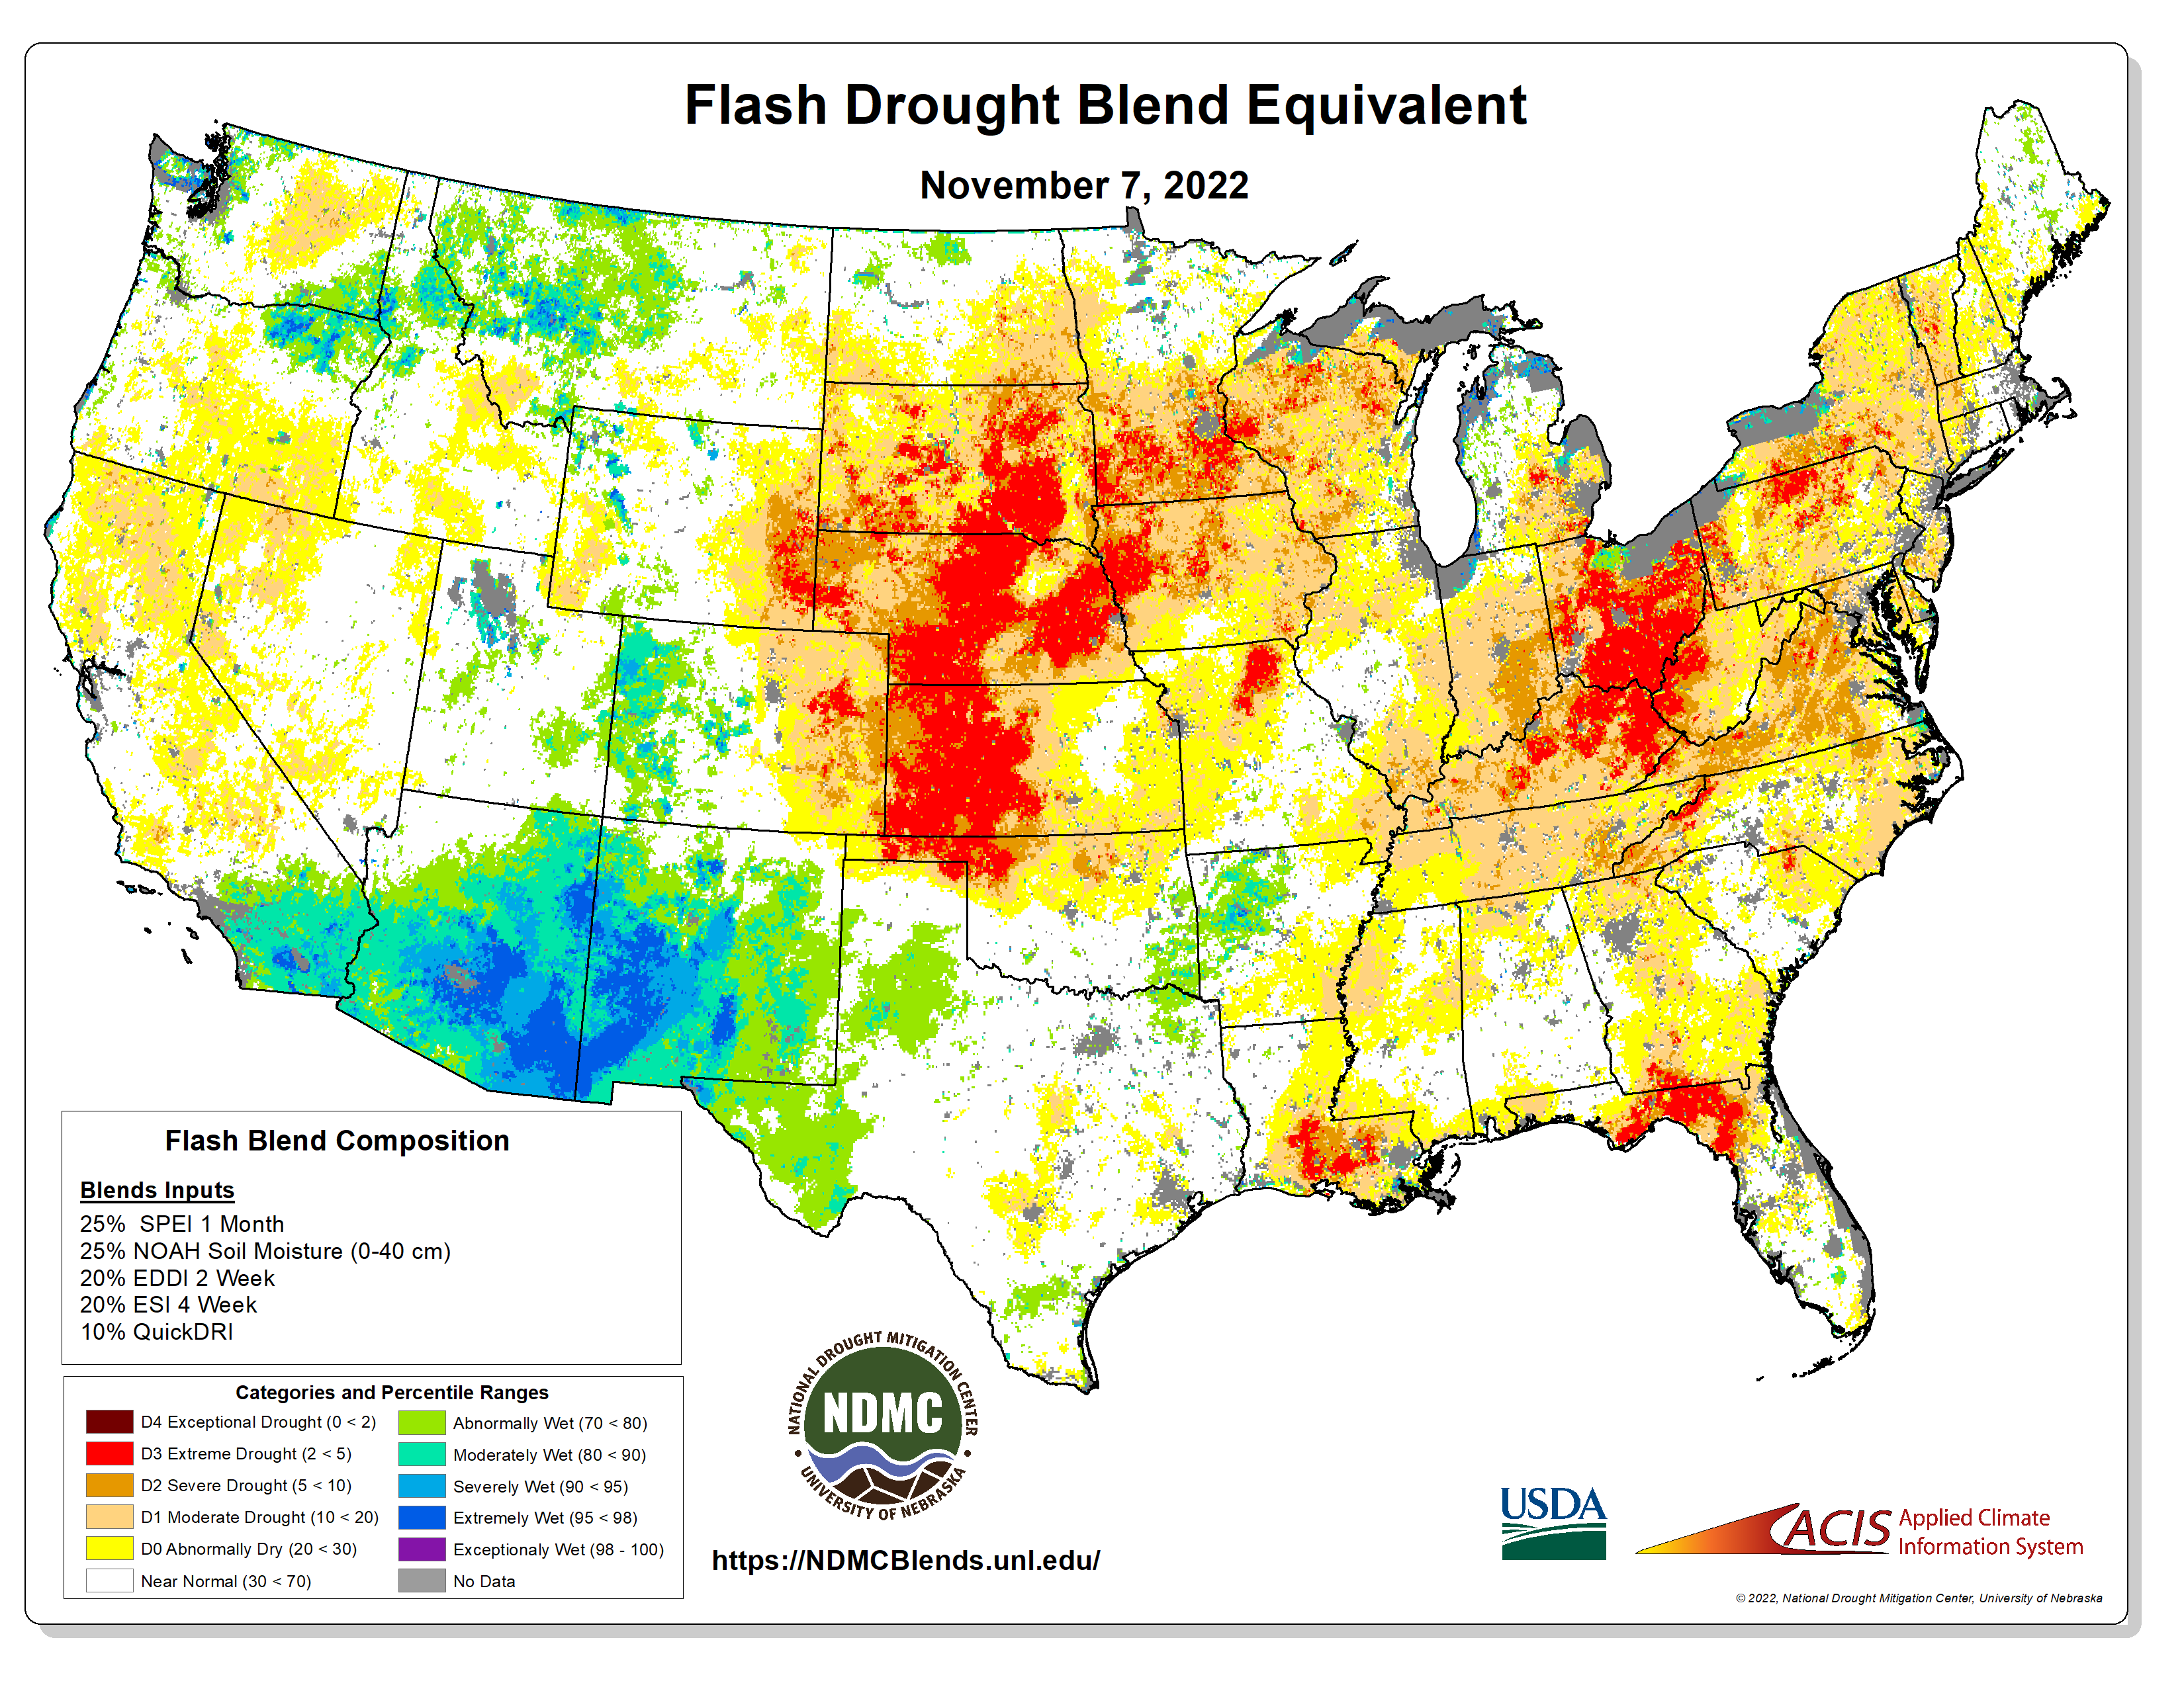
New Tools:

Slide 15
Past and Present NDMC International
Combined Drought Index (CDI) Activities
Brazil
Australia
Middle East & North Africa
Southern Africa
NATIONAL DROUGHT MITIGATION CENTER
Notes:
Monitoring products that blend multiple drought indicators and indices into a single product are often referred to as a combined drought index. The National Drought Mitigation Center has developed CDI for the United States and has worked with countries around the globe to do the same. A few of those are shown here. Including:
Brazil
Australia
Multiple countries in the Middle East and North Africa Region and In Southern Africa.

Slide 16
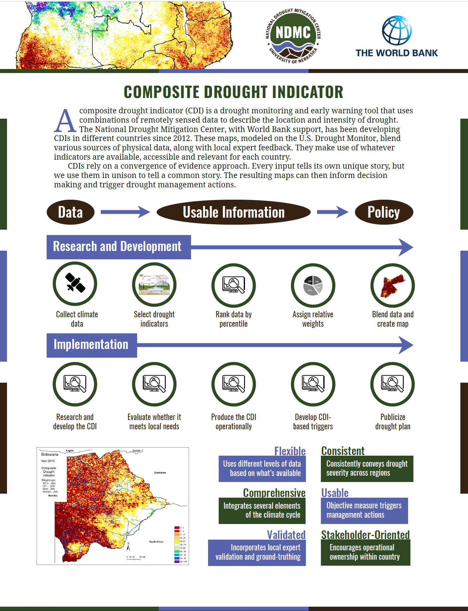
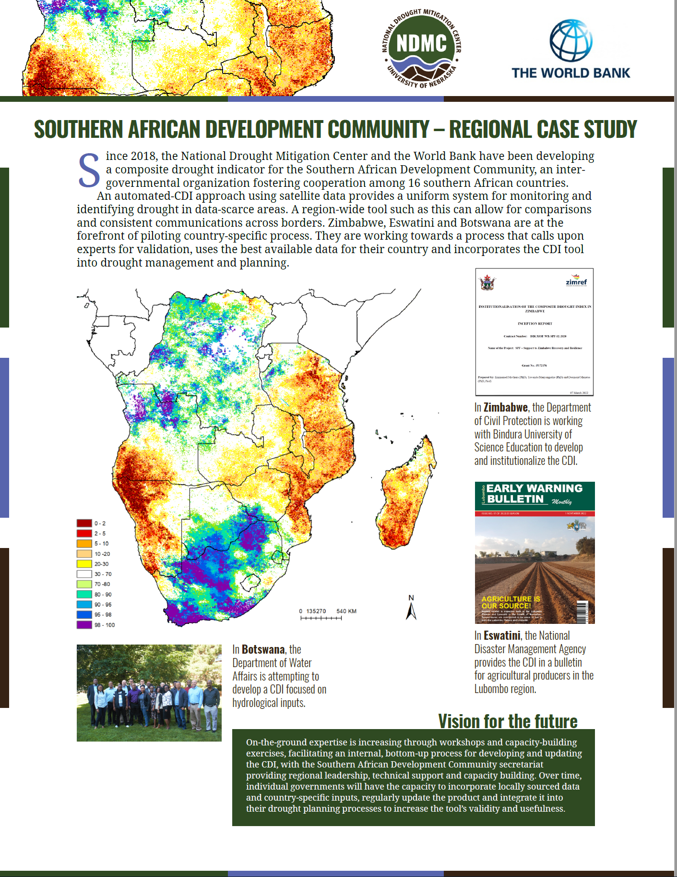
World Bank Applications

Slide 17
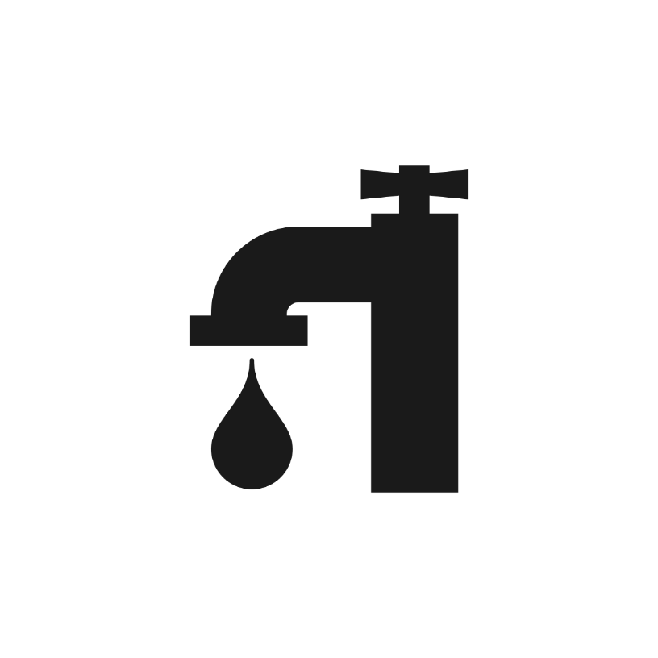




Drought impacts
Drought
Effects
Water
supply
Agriculture
Fire
Tourism
Notes:
Define drought impacts. Cause & effect. Example impacts.

Slide 18
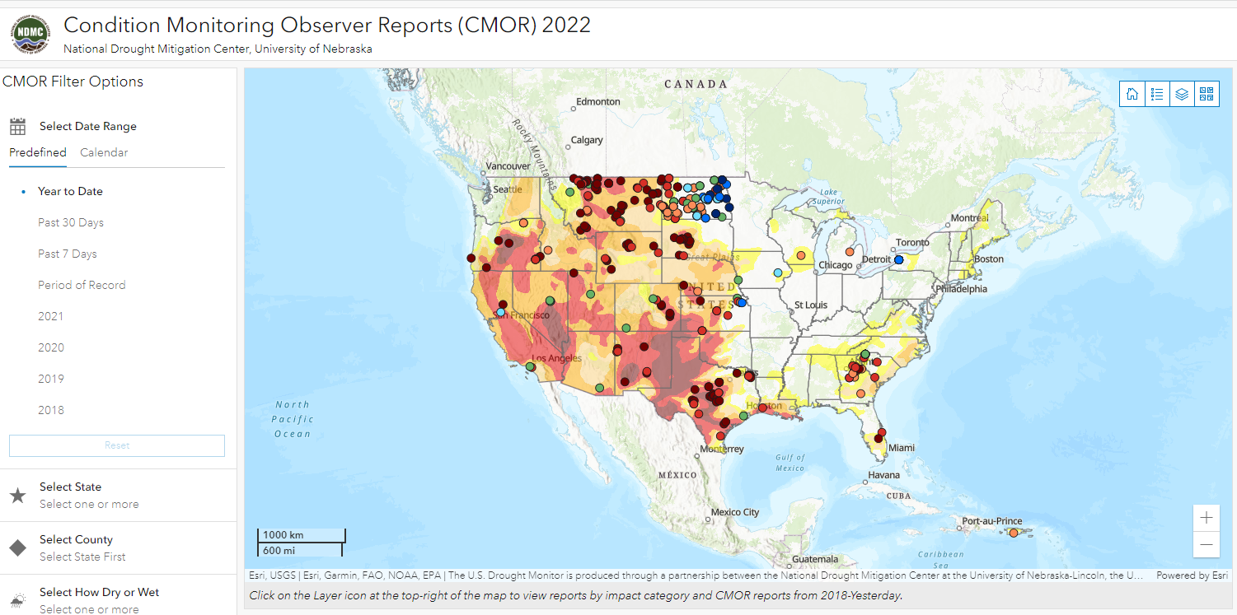
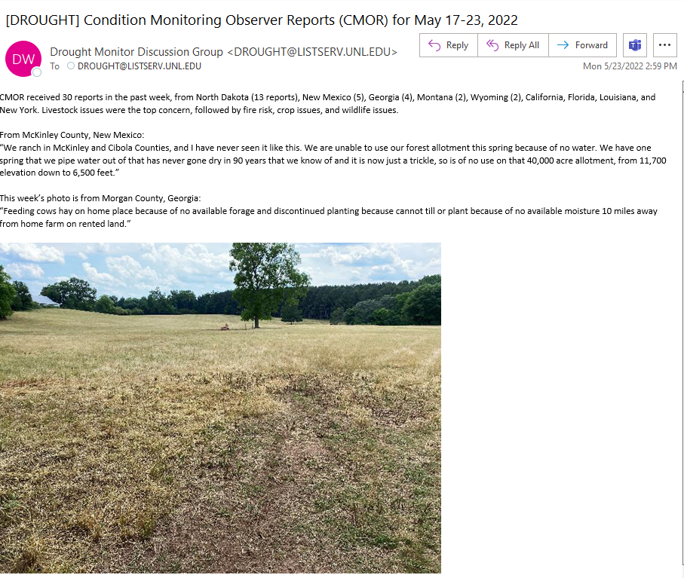
Submit condition/impact reports to the NDMC’s CMOR database/viewer
https://droughtimpacts.unl.edu/Tools.aspx
Notes:
Finally, we have the NDMC Condition Monitoring Reports, which is a more intensive process. Kelly spoke about this earlier. You sign up and submit information for a specific sector by responding to a series of survey questions.
Authors don’t currently get these in a map layer, but can go to the interactive tool to review reports. NDMC staff also summarize and email these impacts to the authors.

Slide 19

If SPIs show dryer than normal conditions here
Impact data show agriculture effects here
DEC | JAN | FEB | MAR | APR | MAY | JUN | JUL | AUG | SEP | OCT | NOV
Critical rainfall
date
How can you use this information?
SPI vs agricultural impacts
Notes:
We don’t have time to go through all of the statistics today, though if you are interested drop a note in the chat box and I’ll be happy to arrange a separate time to go over them with you.
If it’s dry in December, Jan, Feb, or March, you’ve got an indication that there will be agricultural impacts in the upcoming year. Probably not all impacts have been collected, so chances increase that something is going to happen.

Slide 20

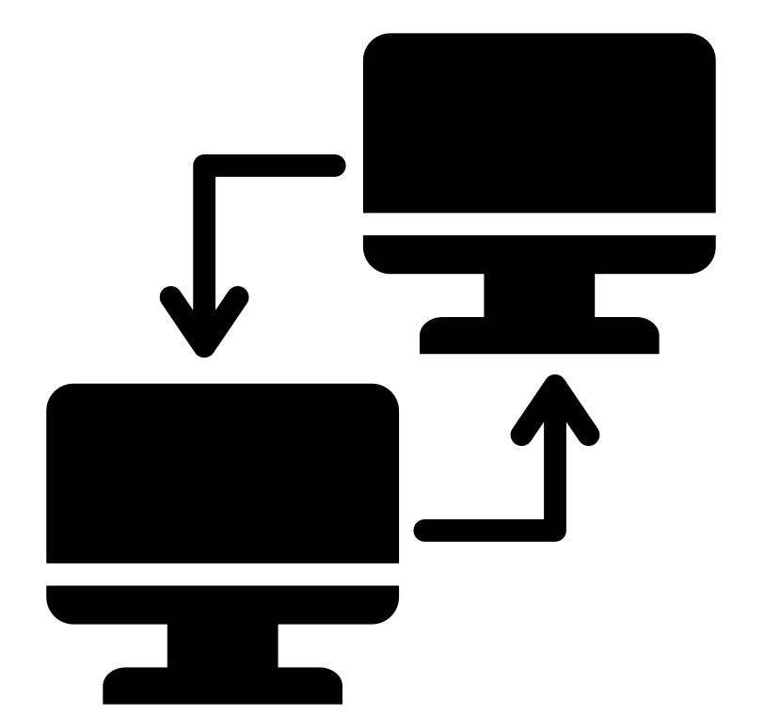


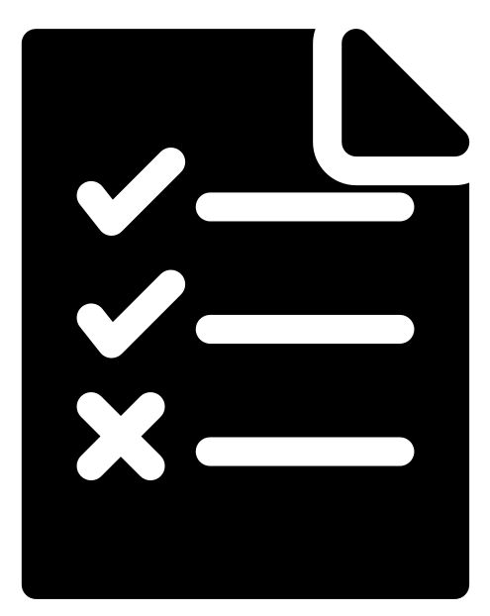



From Science to Action: Integrating Monitoring into Policy
1 | 2 | 3 | 4 | 5 | 6 | 7
Research and develop the CDI | Receive the operational CDI from the research team | Evaluate the CDI to see if it meets decision-making needs | Produce the CDI operationally to see if the process is realistic | Link the CDI to triggers that initiate drought management actions | Make it official by documenting it in a drought plan | Publicize the drought plan to increase awareness and create consensus
Project team
Country Partner
NATIONAL DROUGHT MITIGATION CENTER
Notes:
This is the general overview process of creating a Combined Drought Index. It illustrates the process we have used in the past with our partners as shown earlier on the global example CDI slide.
In the first step the research team researches and develops the combined drought indicator. This includes looking at data availability and access and working with the country partners to identify potential indicators.
Next, the research team delivers the framework for the operational CDI.
Step 3 is to evaluate the CDI to determine if it meets decision-making and stakeholder needs
Step 4 is to begin to produce the CDI operationally to ensure that the process is realistic given the available resources.
Step 5 is to develop triggers based upon the CDI to initiate drought management actions based on drought severity levels
Step 6 is to make it official by documenting the monitoring process and triggers in a drought plan
Finally, step 7 is to Publicize the drought plan to increase awareness and create consensus
Note the transition and hand-off between the project team/consultant team (e.g., NDMC/World Bank) and the partner.

Slide 21
Early Warning and Risk Management Relationship: A cycle forms…
As monitoring and early warning systems improve, the need for better drought risk management strategies (planning and mitigation) increases
As planning and mitigation strategies are implemented, the need for improved drought monitoring and early warning increases
Information (value added) and a need for triggers drives this cycle…

Slide 22
Final Thoughts
The NDMC is dedicated to developing usable information and services
  Involve a variety of networks and incorporate user feedback at all times in what we do!
Strong partners and collaborations on the ground with our stakeholders at all scales (personal, local, watershed, NRDs, state, regional to national + international) has been the key to our success
Goal is to link scientific knowledge w/ the actions needed to reduce impacts and future risk through a sound drought risk management process
Notes:
Continuum: a unique feature of the NDMC (very few organizations span the entire continuum)

Slide 23
Thank You!
Questions?
Contact: Mark Svoboda
msvoboda2@unl.edu
ON THE WEB
drought.unl.edu
@droughtcenter
@droughtcenter

